Slide 1
Google+ for Sourcing & Recruiting
Jeremy Roberts, SPHR
Editor – SourceCon.com
DFWTRN Luncheon 1/8/2014

Slide 2
Who is this guy?
Editor of SourceCon.com
Veteran of recruiting and staffing industry (Agency, RPO, corporate leadership roles)
Lives in Denton with wife, Kristi, and 3 children
Twitter: @imJeremyR
Google+: google.com/+JeremyRoberts
Linkedin: linkedin.com/in/jeremyroberts

Slide 4
Why Google+
Google+ Has 540 Million Active Users
2nd to Facebook
Google continues to integrate all products with the Google+ “social layer”
Google Authorship
Increased trust

Slide 5
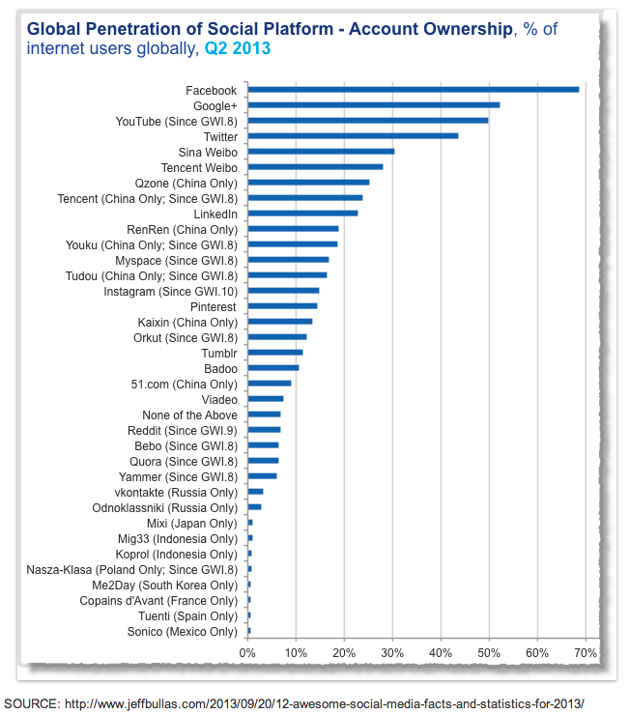

Slide 6
Google Products
Gmail
Google Apps
Google Drive
Google Search Products
Adwords
Youtube
Hangouts and Hangouts ON AIR
Instant Messaging
Google Voice

Slide 7
Boolean Operators and Modifiers
Operators:
AND - Use to find more than one word.
example: Aerospace AND defense
OR - Use to find one word or another (one can also use “|”)
example: Aerospace OR defense / Aerospace | defense
NOT – To exclude a word from a search use the – sign
example: -job –jobs –resume -cv
Modifiers:
Quotations – To find an exact phrase use quotation marks
example: “El Segundo, CA” AND “company name”
Parenthesis – to separate a portion of the equation in order to use multiple operators use parenthesis
example: (aerospace OR defense OR DoD) AND “El Segundo, CA”

Slide 8
Basic Field Search Commands
To find a word in a website title – intitle:
To find a word in a URL – inurl:
To search for documents on a specific site, commonly referred to as the Xray technique use – site:
To search for a certain type of document - Filetype: (pdf doc xls)

Slide 9
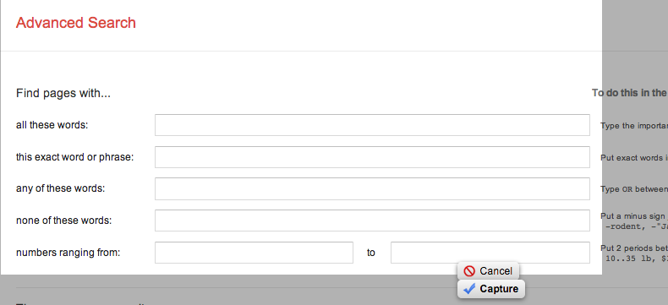
Google Advanced Search
http://www.google.com/advanced_search

Slide 10
Elements of a Google+ Profile

Slide 11
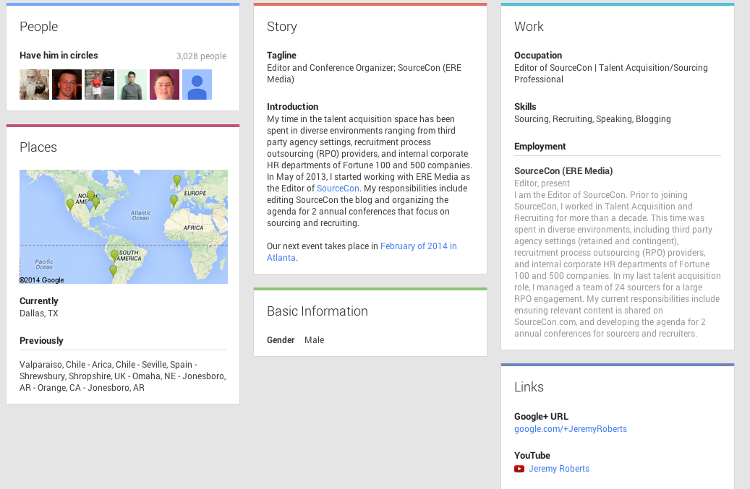
Elements of the Profile

Slide 12
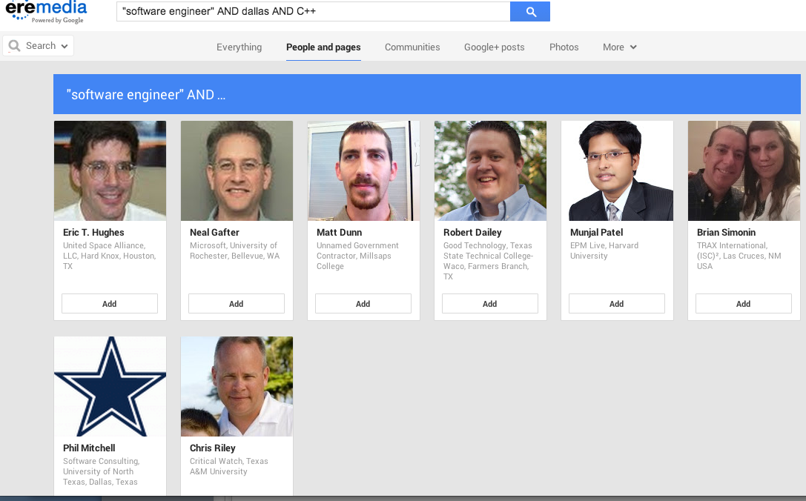
Google+ Search Bar

Slide 13
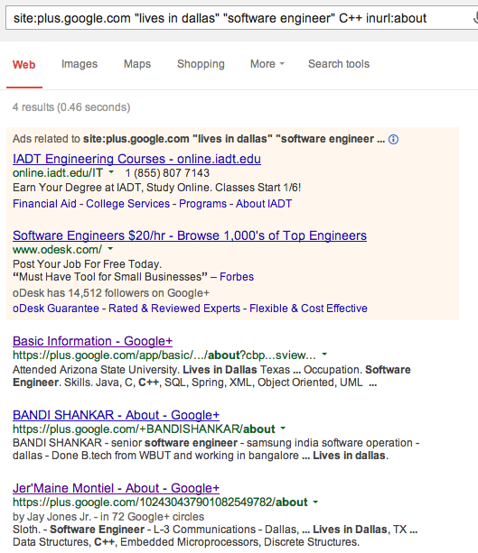
X-Ray: “Lives In”

Slide 14
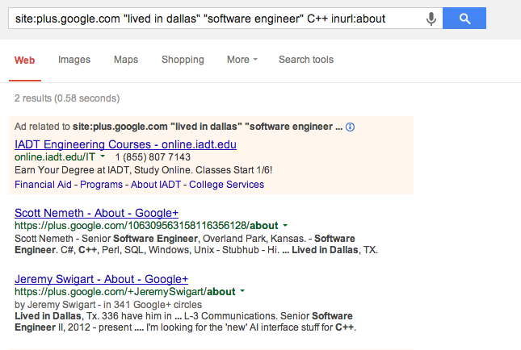
X-Ray: “Lived In”

Slide 15
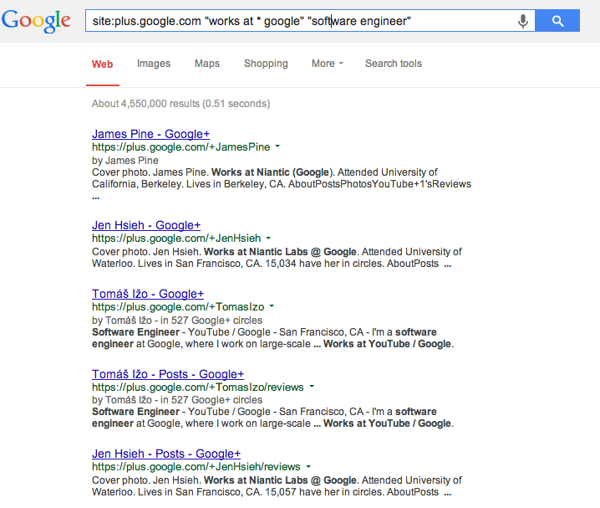
X-Ray: “Works At”

Slide 16
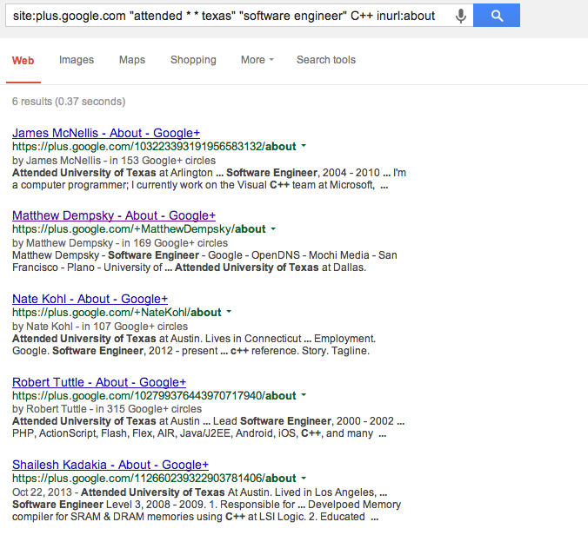
X-Ray: “Attended”

Slide 17
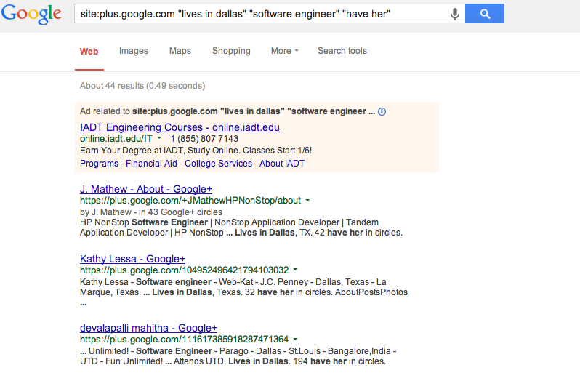
Diversity Search (females)

Slide 18
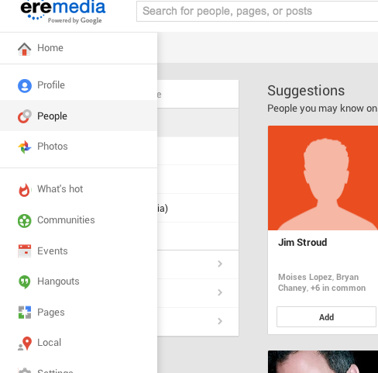
Find Co-Workers Trick
Click on “People” in left column

Slide 19
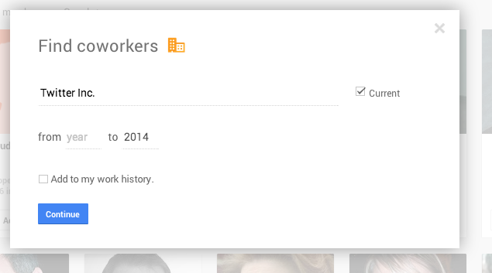
Click on “Find Co-workers”

Slide 20
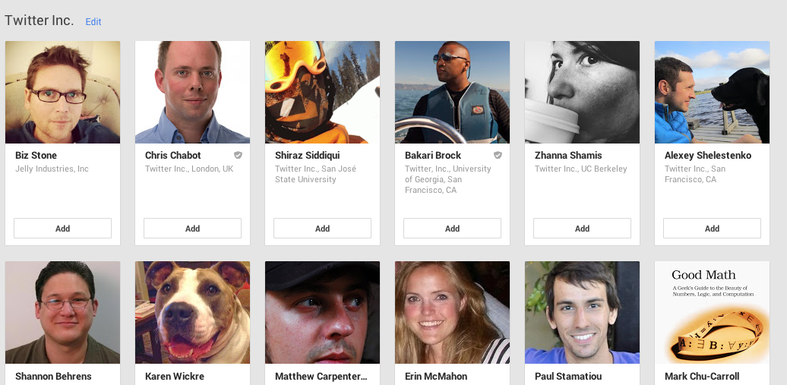
Enter the company name you want profiles from…

Slide 21
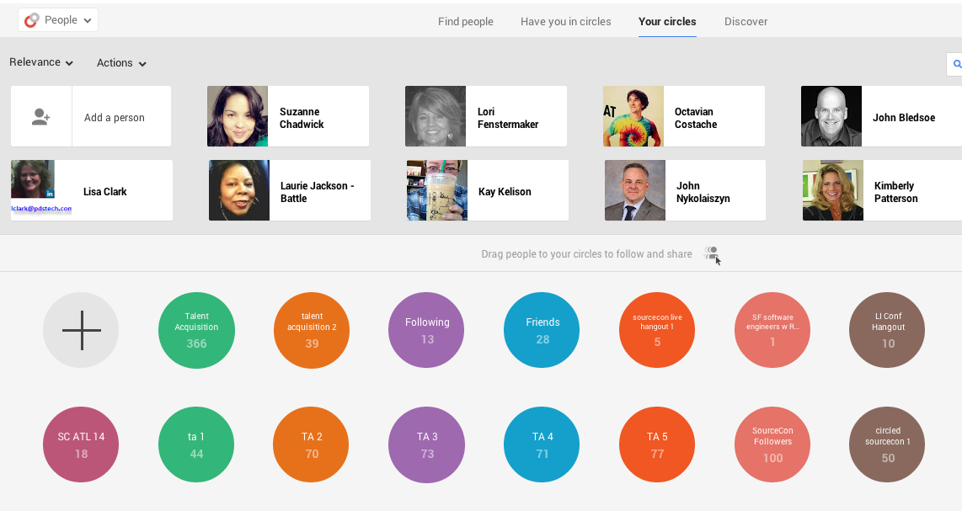
Managing Circles

Slide 22
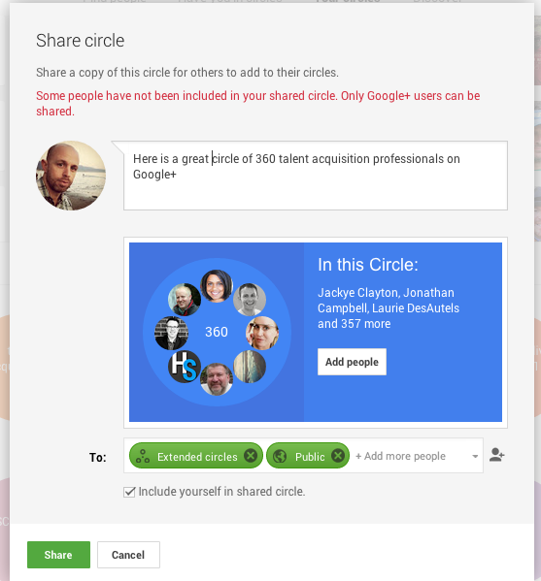
Sharing Circles

Slide 23
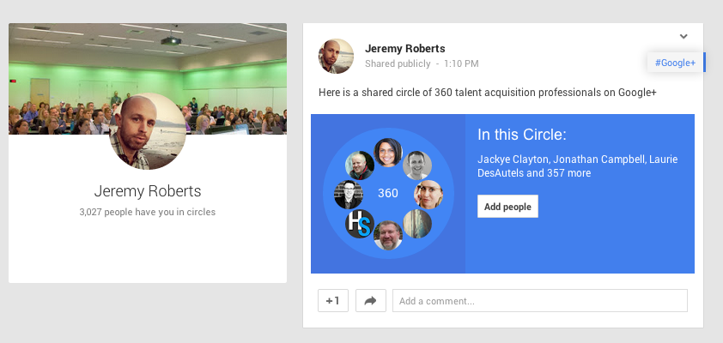
Shared Circle in the Stream

Slide 24
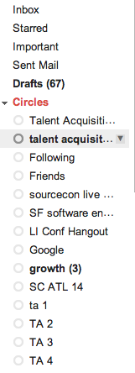
See contact info for your circles in Google Contacts
http://contacts.google.com

Slide 25
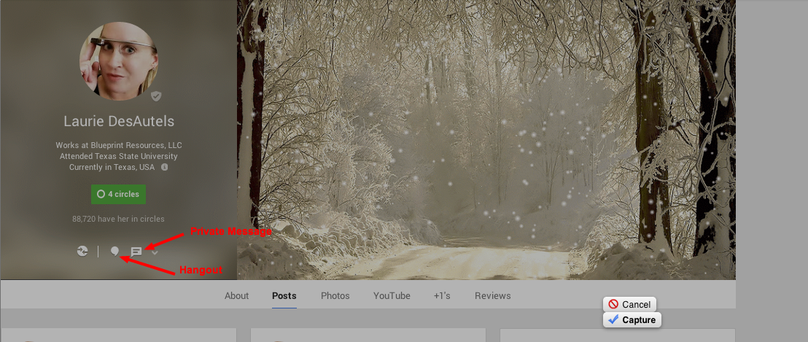
Messaging on Google+

Slide 26
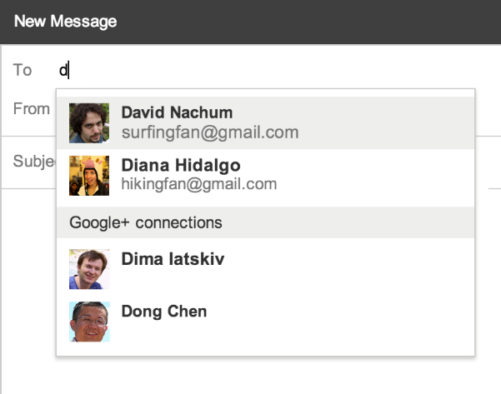
Email circled G+ users via Gmail
It is now possible to email G+ users in your circles from your Gmail account
Open a new email and start typing a users name. The autocomplete box will display a list of users in your circles.
You won’t be able to see their actual email address until they send you an email.

Slide 27
Hangouts and Hangouts ON AIR
Hangouts - Free Video Conferencing
Hangouts ON AIR – Stream live on Youtube
Up to 10 can participate
Great for discussing topics of interest to your audience, conducting group interviews, discussing open positions with hiring managers, building community around a topic.

Slide 28
Google Authorship
Google authorship links your Google+ profile to the content you create.
Benefits brands and individuals
Increased credibility when search results are displayed

Slide 29
SourceCon Atlanta 2014
SourceCon returns to Atlanta on February 19-20, 2014
Register here:
http://www.sourcecon.com/2014atlanta/

