Slide 1
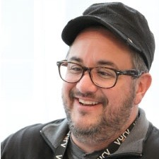
Creating Candidate Micro-Moments That Matter
William Tincup, President
RecruitingDaily
DFW Texas Recruiters Network (DFWTRN)
Wednesday, February 5th, 2020
The Clubs of Prestonwood

Slide 2
Micro-Moments As defined by Google, a “micro-moment occurs when people reflexively turn to a device—increasingly a smartphone—to act on a need to learn something, do something, discover something, watch something, or buy something. They are intent-rich moments when decisions are made and preferences shaped.” May 16, 2017

Slide 3
This weekend get 2 tattoos… Left forearm = Highly & Exceedingly Right forearm = Magnanimous & Personalized Highly, to a high degree Exceedingly, to an extreme degree Magnanimous, a lofty and courageous spirit Personalized, to make personal or individual

Slide 4
Before we get started, part un Thoughtfully consider critical candidate moments that are universal Heavy emphasis on thoughtfully

Slide 5
Before we get started, part deux Everything we do must be magnanimously candidate centric The customer is ALWAYS right. True or not true? The candidate is ALWAYS right. True or not true?

Slide 6
Before we get started, part trois We’re NOT in a war for talent, we never have been. It was all a lie. We’re in a war with ourselves. We always have been. That’s the truth. How do we possibly get our massively difficult jobs done whilst being magnanimous and creating highly personalized candidate experiences?

Slide 7
Let’s just say the candidate journey looks something like this, part un 1. Candidates are aware and have interest in your job/company/employer brand 2. Candidates apply to your jobs 3. Candidates expect communication from jobs they apply to from you 4. Candidates are assessed, screened & given feedback a. Candidates are rejected & communicated with b. Candidates that go forward receive concise communication regarding next steps a la the journey

Slide 8
Let’s just say the candidate journey looks something like this, part deux 5. Candidates interact & communicate with recruiters a. Candidates meet IRL with recruiters b. Candidates meet digitally with recruiters c. Candidates have phone calls with recruiters 6. Candidates interact & communicate with hiring managers a. Candidates meet IRL with hiring managers b. Candidates meet digitally with hiring managers c. Candidates have phone calls with hiring managers 7. Candidates interact & communicate with the team a. Candidates meet IRL with the team b. Candidates meet digitally with the team c. Candidates have phone calls with the team

Slide 9
Let’s just say the candidate journey looks something like this, part trois 8. Candidates are graded out by the internal hiring team a. Candidates are rejected & communicated with b. Candidates that go forward receive concise communication regarding next steps in the journey 9. Candidates negotiate & receive job offer a. Candidates reject the offer b. Candidates accept the offer 10. Candidates that accept the offer participate in pre- boarding activities

Slide 10
It isn’t easy but it CAN be done. I promise. Here are just a few examples of candidate thoughtfulness in the form of micro-moments that matter. 3, 2, 1, go…

Slide 11
Candidates are aware and have interest in your job/company/employer brand Your sourcing team found Sally, she’s awesome, discover her hobbies.

Slide 12
Candidates apply to your jobs Sally is now in your system. Follow her on Twitter and RT a few of her tweets.

Slide 13
Candidates expect communication from jobs they apply to from you Sally, thank you. I’m really excited that you applied. Next on the agenda is…

Slide 14
Candidates are assessed, screened & given feedback Sally, you passed all the tests. What would like to learn about us?

Slide 15
Candidates are rejected & communicated with Jan, you’re amazing. This role wasn’t the right fit for you. KIT. We’ll figure it out. We want you on our team. Would you like to talk on the phone?

Slide 16
Candidates that go forward receive concise communication regarding next steps a la the journey Sally, you’ll talk with recruiters, hiring managers and the team that you would be working with. How can I make this process easy for you?

Slide 17
Candidates interact & communicate with recruiters Sally, what would you like to learn about me, the hiring managers, the team, our company, our culture, our CEO, etc? I want you to feel comfortable with both our hiring process and explicitly how we treat you during this process. I want you to win. I’m your advocate. Think of me as such.

Slide 18
Candidates meet IRL with recruiters Sally, we’ve made a parking spot for you up front (to the left of the handicapped parking spaces). I’ve attached the map to our office and I think your commute time will be about 30 minutes or so.

Slide 19
Candidates meet digitally with recruiters Sally, thanks for being on Skype with me today. I wanted to ask for your feedback from our interview last Thursday. What could I have done better and what question(s) should I have asked? I’m always trying to get better.

Slide 20
Candidates have phone calls with recruiters Sally, during our last interaction you mentioned drone racing. Tell me more about that. How did you get started and I’m asking because my son might be interested in that. Could you give me a few pointers?

Slide 21
Candidates interact & communicate with hiring managers Sally, the hiring managers will ask deeper questions about your capabilities. They want to know two things (1) what are the current edges of your experience and (2) can they see you pushing the team (in a good way)? That’s essentially what they care about. No prep, just be yourself and know why they are asking the questions they’re asking. You got this.

Slide 22
Candidates meet IRL with hiring managers Sally, what’s your favorite drink and snack? During your time with the hiring managers, you’ll be taking multiple brain breaks and I want you to have things you like readily available. Plan for about three hours. They usually rotate 6 different managers in and out of the interview. That’s why the breaks are important (for you and them). You got this.

Slide 23
Candidates meet digitally with hiring managers Sally, as you know, we have some folks in the UK that want to meet you. We’ll use Zoom for the call. Please make sure your webcam works, the room is well lit and your background is solid. As this meeting is both visual and the words you say, it’s important that you present well to these folks. I’ll practice with you 30 minutes before your call. You’ll be fine.

Slide 24
Candidates have phone calls with hiring managers Sally, Dan who you met here at the office wants to ask you a few more questions about what your want to learn while at our company. He’s responsible for building out development plans for folks. The call is all about you and what you want to learn. It should be a rather easy and quick call. Call or text me after the call with Dan.

Slide 25
Candidates interact & communicate with the team Sally, everyone on the team is excited to meet you. They’ve reviewed your resume. They’ve reviewed my and the hiring managers notes. They’ve reviewed your LinkedIn profile and followed you on Twitter. The point being, they’ll know a bit about you. Here are their names, LinkedIn profiles and Twitter accounts so you can do your own research if you want.

Slide 26
Candidates meet IRL with the team Sally, the next step in the process is meeting with the team you’ll be assigned to. These meetings are normally brainstorming meetings. They’ll take you through a current project and see what you think. Specifically, they’ll tell you where they’re hitting a wall. They want to see you in action. They want to see how the room flows. Be true to yourself and blow them away with your brilliance. You’ll enjoy the meeting. I promise.

Slide 27
Candidates meet digitally with the team Sally, as you know, Denise couldn’t make the team meeting. She was out with the flu. She’s excited to talk with you as she already feels like she knows you. This won’t be a brainstorming session. She mainly wants to know what you thought of the team meeting and how we could make that better for folks like you. She’s a complete geek so make sure you bring up your experience with drone racing. You’ll like Denise.

Slide 28
Candidates have phone calls with the team Sally, our CEO, Janet wants to talk with you. She’s heard all about you and wants to see if you have any questions about the company and our culture. She’s based in London which is 5 hours ahead of you. It will be a 20 minute call and she just wants to make sure you like what you’ve seen, read and heard. I’ll work with you and Janet to get the call scheduled.

Slide 29
Candidates are graded out by the internal hiring team Sally, right now everyone is comparing notes on their interactions with you. Every single conversation will be analyzed and discussed. This is where in the process they all assign grades for you on eight different levels (we discussed this during our first call). Mostly they want to make sure they all saw the same thing in you and that you align with both the team and the values of our company. Don’t be nervous, this is the final stage of their involvement in the hiring process. They want to make good decisions so expect to talk with me on Monday. I’ll text you if I know something sooner.

Slide 30
Candidates are rejected & communicated with Sally, bad news and good news. The local team passed on you for some very specific reasons that I’d like to talk with you about over coffee or a call. The good news is that the UK team was so impressed with you that they want to start a hiring process with you. No guarantees but they’ve expressed interest and I think you should at least hear them out. So, you didn’t get this job. I know you’re disappointed. Let’s talk soon okay.

Slide 31
Candidates that go forward receive concise communication regarding next steps in the journey Sally, OMG, greatest news ever. The entire team loves you and wants you to start immediately. I’ve never seen them like this. It’s weird but cool. Okay, let’s talk next steps. We’ve talked comp. What else is on your list of must haves? The next step in the process is for me to conjure up an offer letter. I’d like to have that done by Wednesday, does that sound good to you?

Slide 32
Candidates negotiate & receive job offer Sally, expect a FedEx package today. I won’t say what it is but the box will also include a signed offer letter from Janet. Text me once you get the package. I’m excited for you.

Slide 33
Candidates reject the offer Sally, I’m bummed but I understand. I want us to stay in touch because this won’t be the last time I try to recruit you. You’ve been amazing throughout this process and I know you’ll do well at anything you choose to do. Thanks for making my job easier and let’s grab coffee in a few months.

Slide 34
Candidates accept the offer Sally, it’s going to be so nice to have you in our office. Normally recruiters fade out as HR takes more of a role in your onboarding and development but I’d like for us to stay in touch AND if you ever need anything, please don’t hesitate to call/text me. Our company just got better, thank you Sally.

Slide 35
Candidates that accept the offer participate in pre-boarding activities Sally, attached is the employee handbook, read it and counter sign the end of the document. Your business cards should reach your house by next Tuesday. I’ll send a separate note regarding your email account so expect that shortly. Lastly, I’ve included our current benefits package. Review and during your first week HR will explain line by line what everything means coverage wise. Do you have any questions before your “officially” onboarded to the company?

Slide 36
Easy peasy lemon squeezy a playful way to describe a difficult task or activity as extremely easy or simple to perform.

Slide 37
Q&A

Slide 38
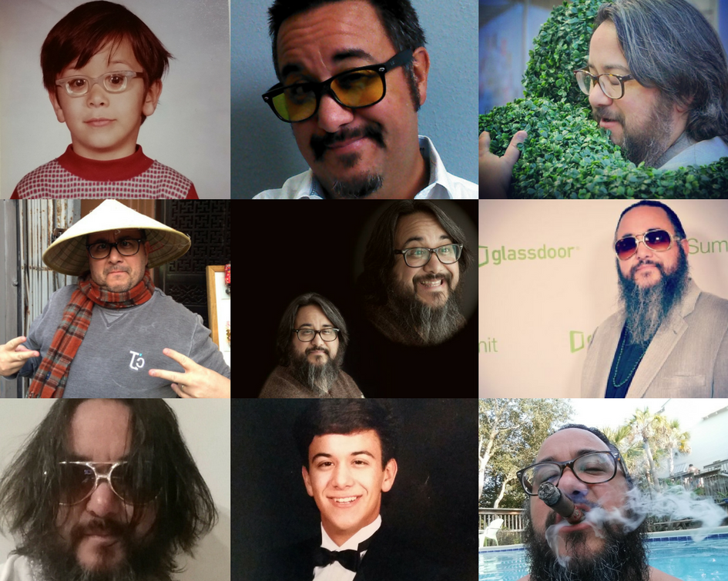
William Tincup, SPHR, SHRM SCP
President, RecruitingDaily
Email
tincup@recruitingdaily.com
Website
http://www.recruitingdaily.com
Instagram
http://instagram.com/williamtincup
Facebook
http://www.facebook.com/tincup
LinkedIn
http://www.linkedin.com/in/tincup
Twitter
http://twitter.com/williamtincup
YouTube
https://www.youtube.com/user/jwilliamtincup
Pinterest
http://pinterest.com/williamtincup
Mobile
+1-469-371-7050
Skype
williamtincup

