Slide 1

Tips and Tricks to Finding Contact Information for Your Leads
Trish Wyderka
DFWTRN
March 6, 2019

Slide 2
Introduction
Prior Air Force veteran (no, didn’t fly planes – just rode in a lot of them ☺)
Expert sourcer for 8 years; cutting-edge electrical engineering technology
LOVE sourcing; addicted to anything Boolean and data mining
Cat mom and sci-fi movie lover

Slide 3

Today I am going to blow your mind with…
Methods for finding contact information, including phone numbers and emails:
* Tools (Free and Paid) to find email or phone numbers for leads
* Boolean Methods (Google)
* Google Chrome Extensions
* Bonus! Tools to verify phone numbers and emails

Slide 4


Tools (Free and Paid) - Find Emails or Phone Numbers
TruePeopleSearch (Free)
  https://www.truepeoplesearch.com/
Cubib (Free)
  https://cubib.com/
FastPeopleSearch (Free)
  https://www.fastpeoplesearch.com/
IntelTechniques (Free)
  Custom Person Search
  Email Search Resources
  Telephone Search Resources
Hunter (100 free per month; $49 per month for 1K searches)
  https://hunter.io/
Melissa
  www.melissa.com/v2/lookups
SpiderFoot
  www.spiderfoot.com

Slide 5
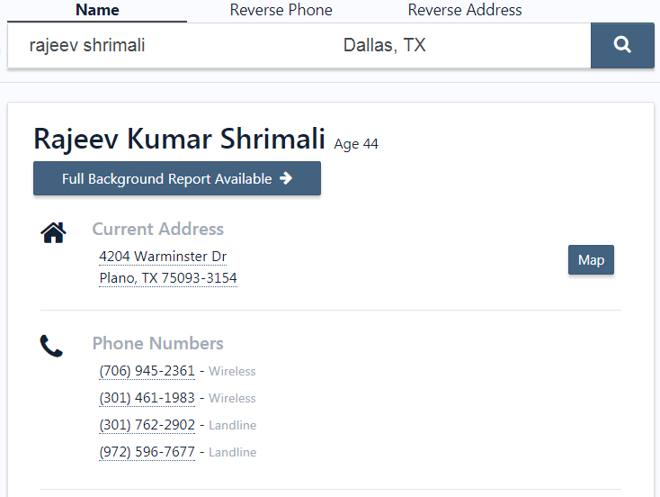
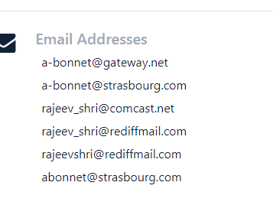
True People Search Site
Free to use
Mobile and home phone
Email addresses

Slide 6

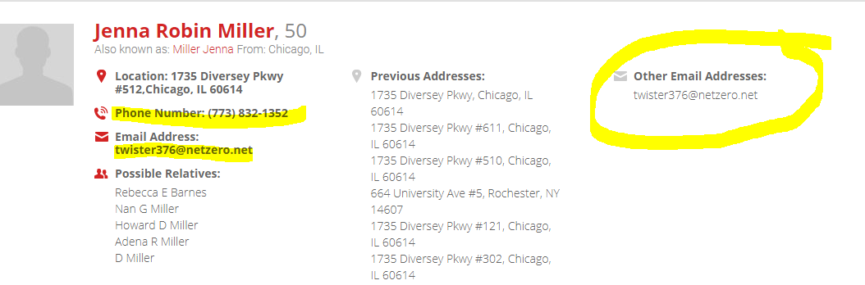
Cubib Site
Free to use
Multiple results may return with email and/or phone numbers

Slide 7
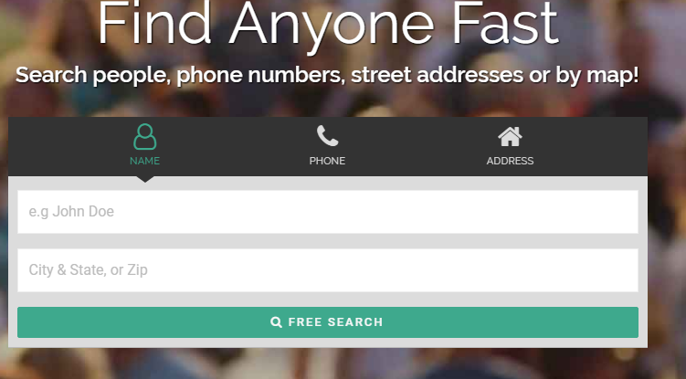
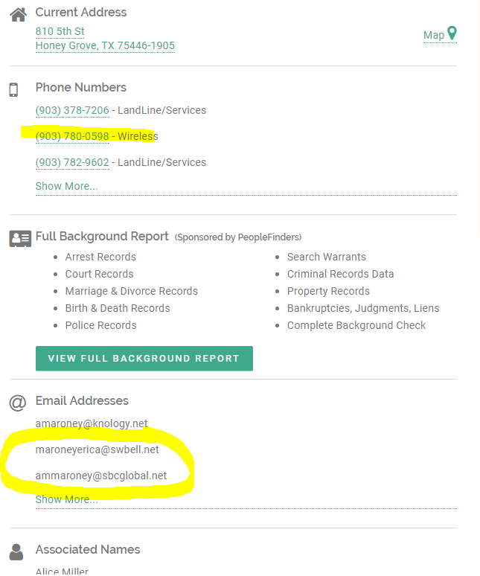
Fast People Search Site
Free site
Enter contact name/location

Slide 8
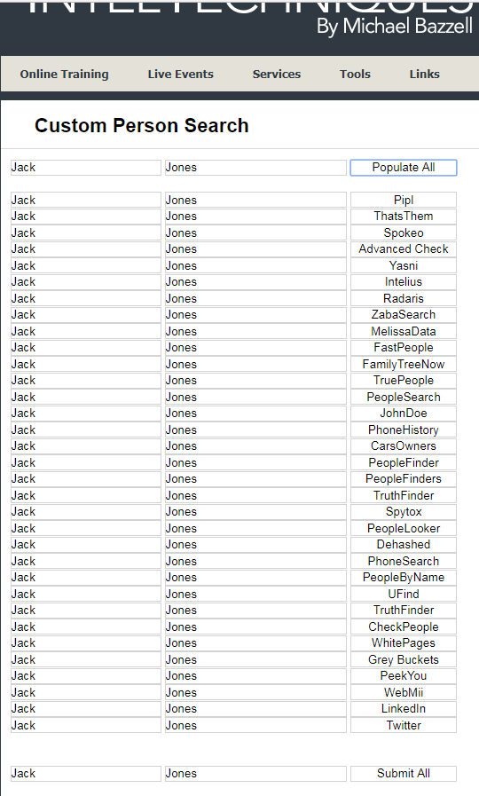

IntelTechniques – Custom Person Search

Slide 9
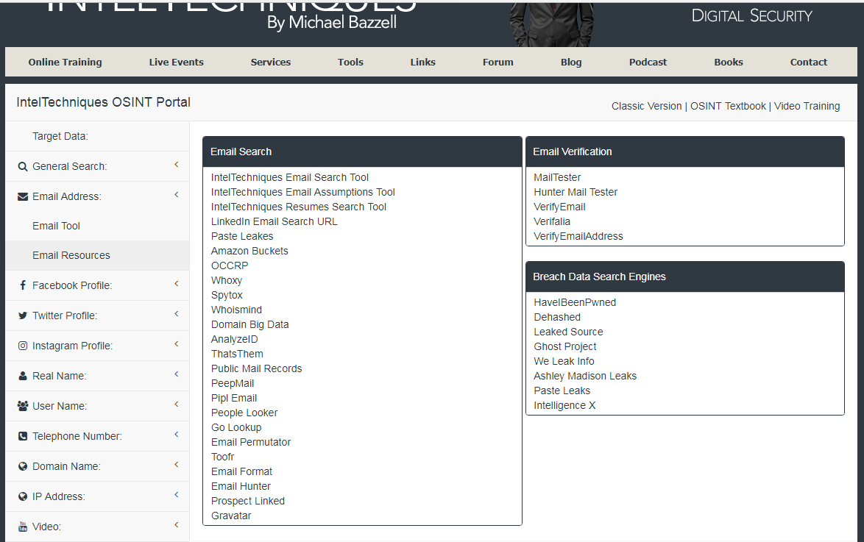
IntelTechniques – Email Resources
https://inteltechniques.com/menu.html

Slide 10
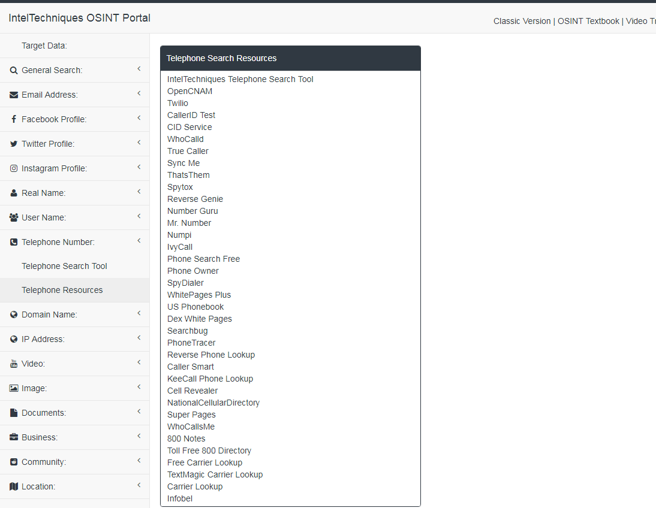
IntelTechniques – Telephone Search Resources
https://inteltechniques.com/menu.html

Slide 11
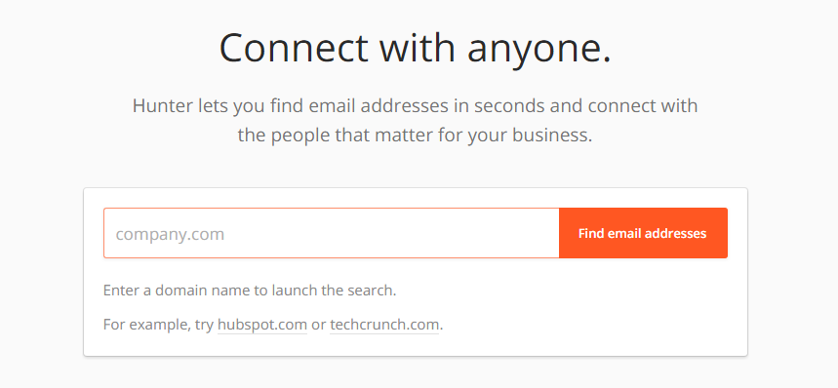
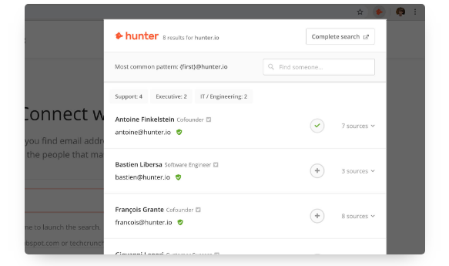
Hunter
First 100 free then starts at $34/month for 1000

Slide 12

Melissa
Melissa helps companies to harness Big Data, legacy data, and people data (names, addresses, phone numbers, and emails).
Sign-up free 1000 pts / Paid version available
Favorites to use for research:
  Business & Professional:
    Personator Search: Find people nationwide by name, address, phone or email
    Global Phone Check: Verify phone numbers worldwide
    Global Email Check: Verify email addresses and get associated name and mailing address

Slide 13
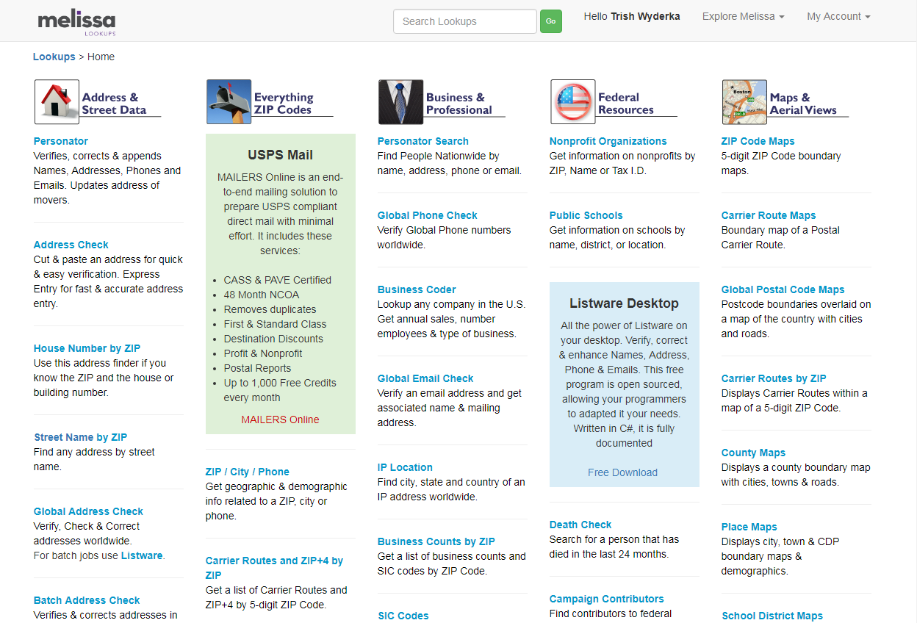
Melissa - Lookup

Slide 14
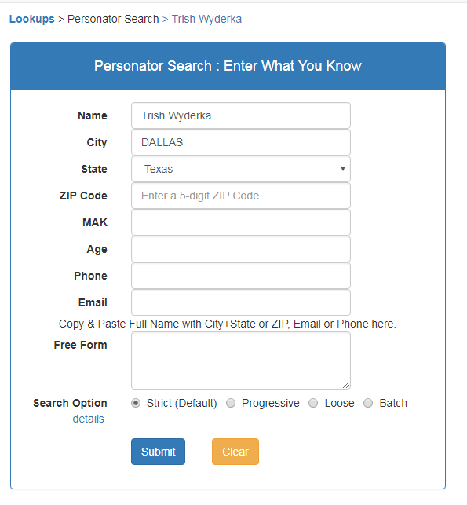
Melissa – Address & Street Data Personator Search

Slide 15
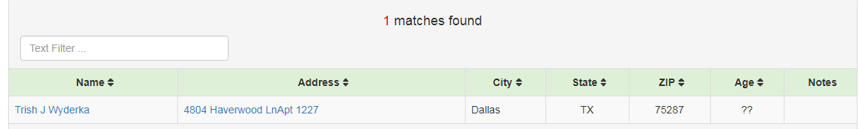
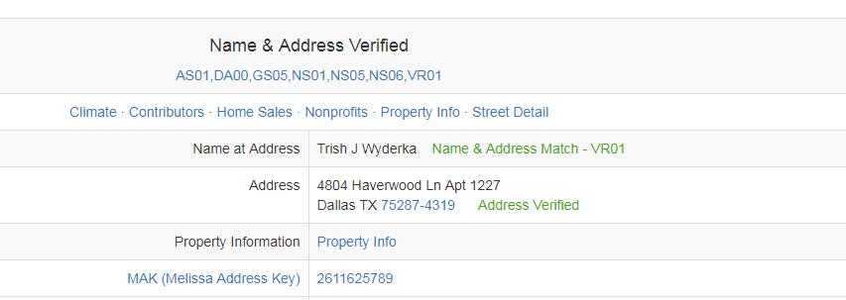
Dig a bit further = Finding additional data…

Slide 16


Entering the “Don’t try this on your work computer” zone…

Slide 17
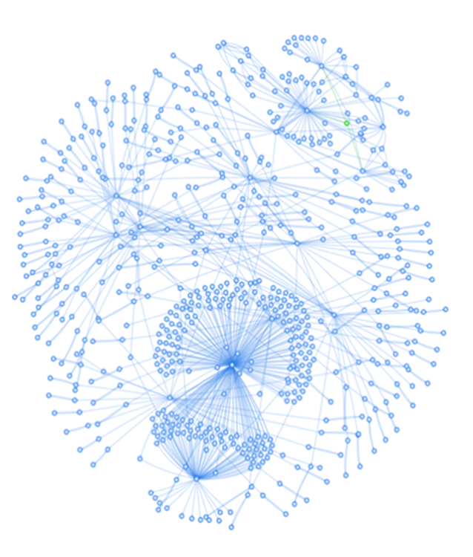
SpiderFoot
Spiderfoot is a tool that automates queries to over 100 public data sources (OSINT) to gather information on IP addresses, domain names and e-mail address and more. The data returned from a SpiderFoot scan will reveal a lot of information about your target
Note: YouTube has videos how to set-up SpiderFoot for your needs (Linux, Windows etc…)
Why use SpiderFoot?
  Alternative to verify emails
  Find alternate data on your leads

Slide 18
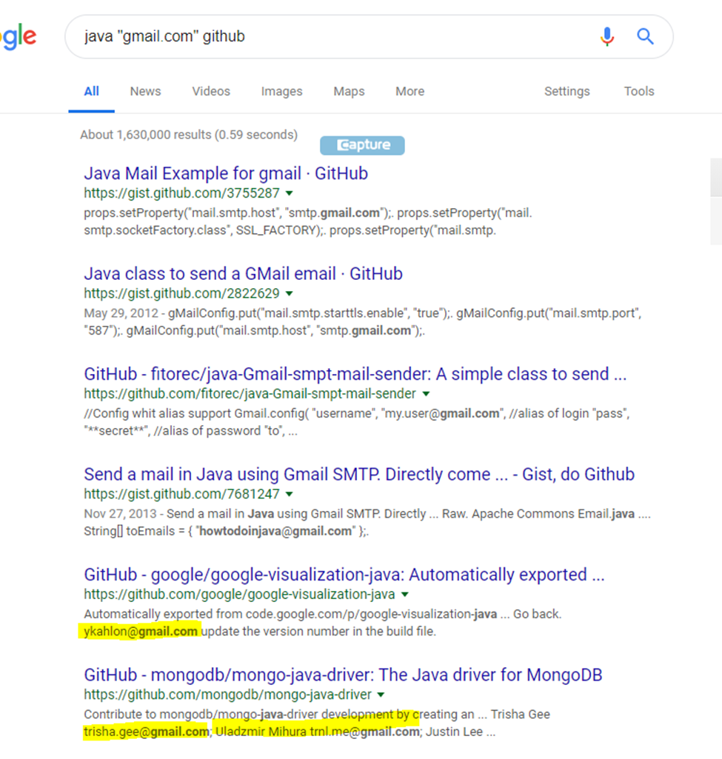
SpiderFoot

Slide 19
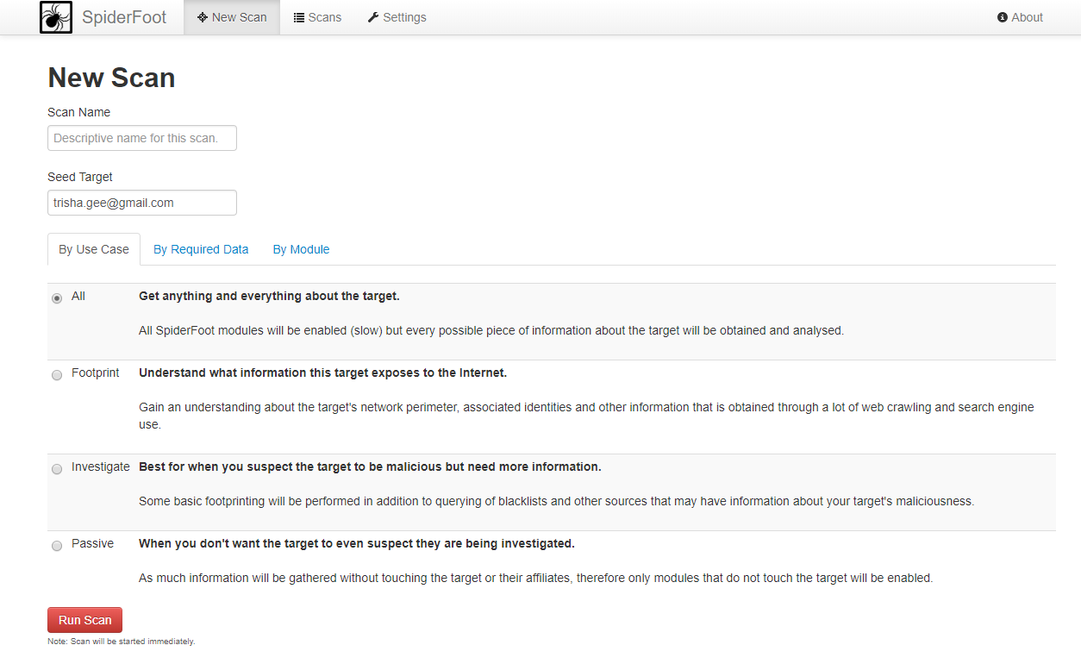
SpiderFoot – Getting started

Slide 20
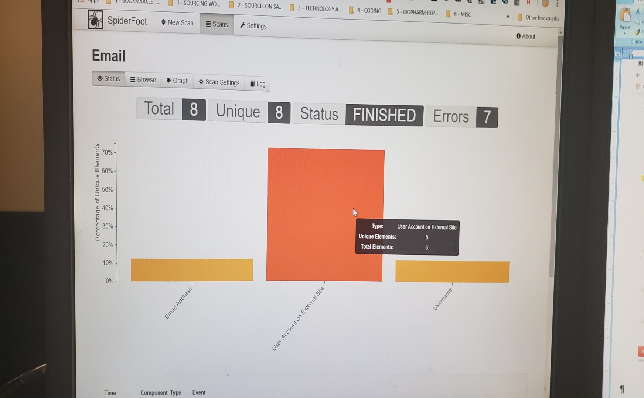
SpiderFoot - Status

Slide 21
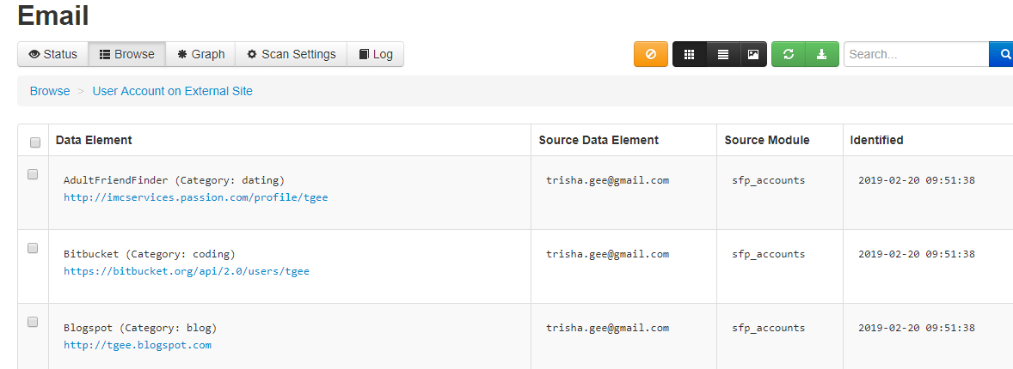
SpiderFoot – User Account on External Site
Look through various sites that return that would be useful (social media, conference, and professional)

Slide 22
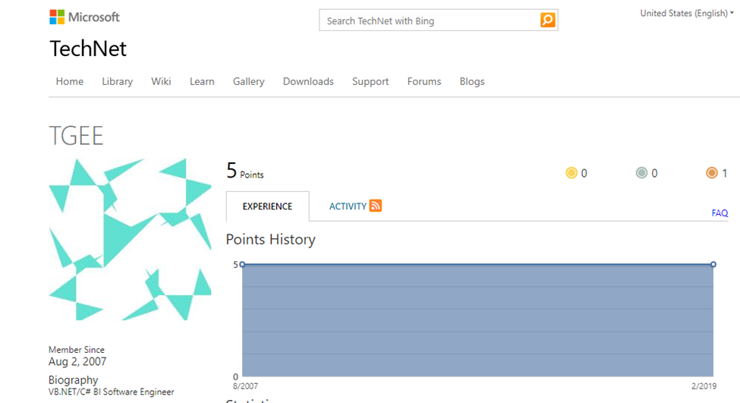
SpiderFoot – User Account on External Site

Slide 23
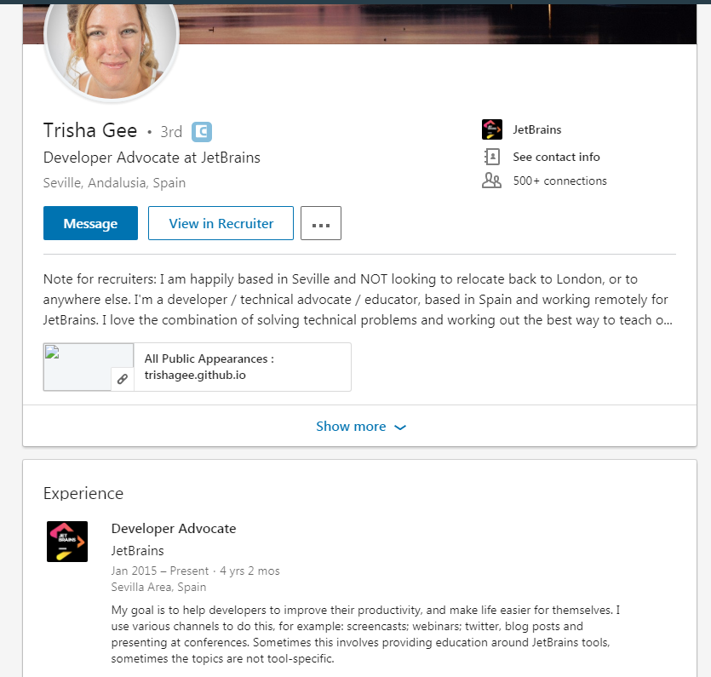
SpiderFoot

Slide 24
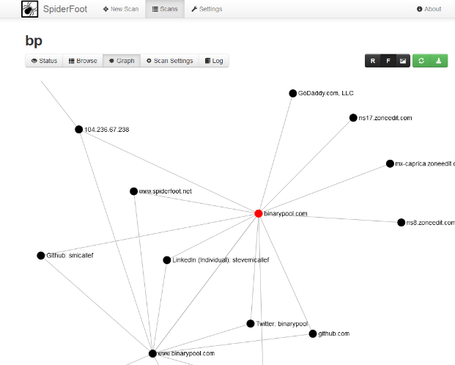
SpiderFoot - Graph

Slide 25
Boolean Methods (Google)
name (contact | email) (“gmail.com | “yahoo.com” | “aol.com”)
(email | mailto | contact | phone) * companyname.com “persons name”
(intitle:resume | inurl:resume) ".net developer" gmail.com | yahoo.com | icloud.com | outlook.com -sample -example
(“call at” | “phone number” | “cell phone”) “software developer” –job –jobs –template -sample

Slide 26
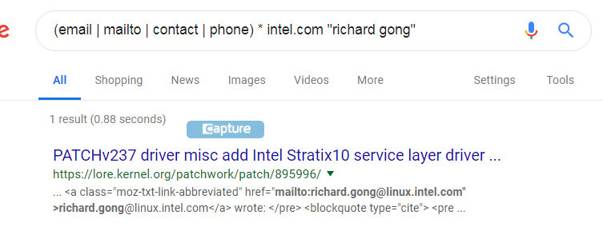
Boolean Methods (Google) continued…
(email | mailto | contact | phone) * companyname.com “name”

Slide 27
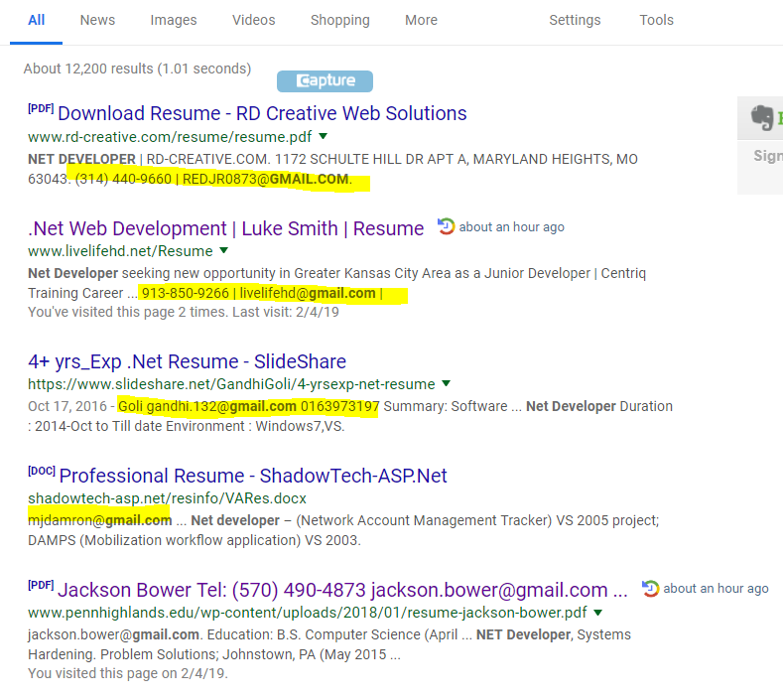
Boolean Methods (Google) continued…
(intitle:resume | inurl:resume) ".net developer" gmail.com | yahoo.com | icloud.com | outlook.com -sample -example

Slide 28

Google Chrome Extensions!

Slide 29

How can Google Chrome Extensions help me?
Extensions will absolutely give you some time back, and make sourcing, recruiting, employment branding and marketing quite a bit easier.
Find emails and phone numbers to your leads – increase chances of connecting with them.

Slide 30
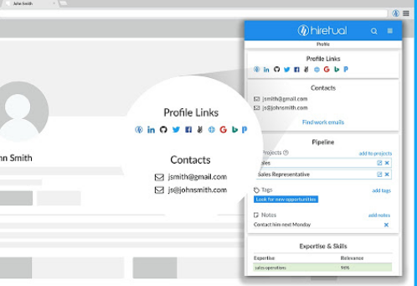
Hiretual
Hiretual: 10 free per week with version; paid version available
Potential emails (personal/office) and phone numbers (office/mobile)

Slide 31
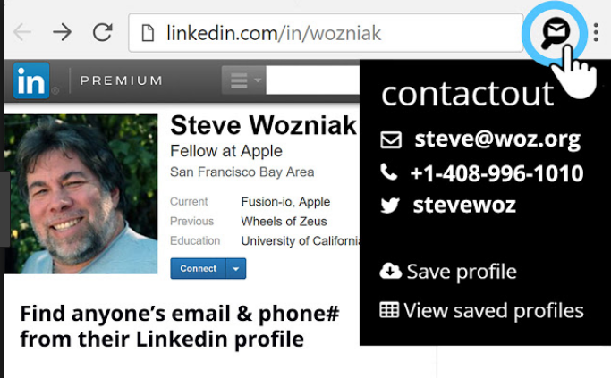
ContactOut
ContactOut: 100 free search credits; paid version available

Slide 32
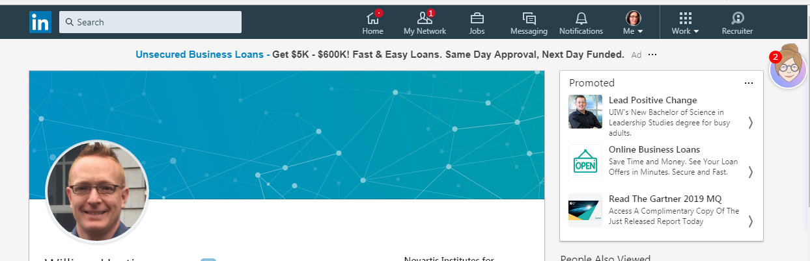
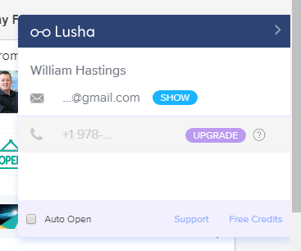
Lusha
Lusha: 5 free per month with free version; paid version available

Slide 33
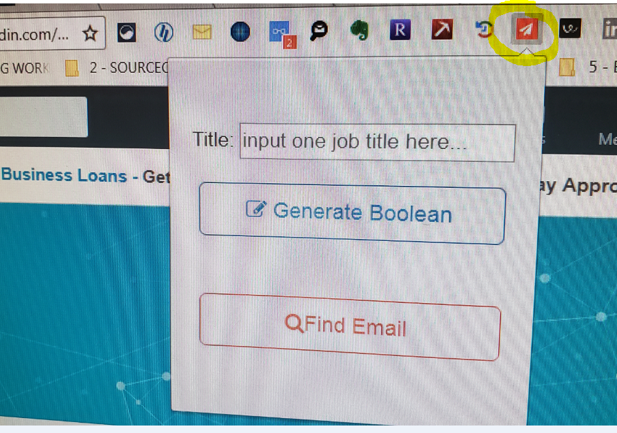
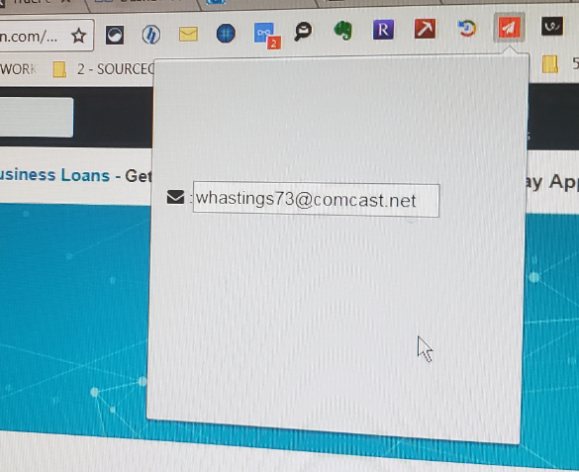
Boolean Assistant
Find emails for FREE!

Slide 34
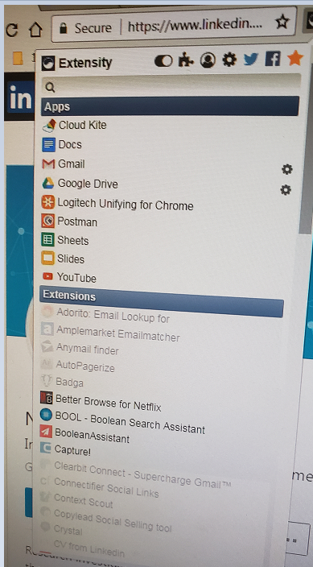
Turn all extensions off (and back on) with a single click. – Unclick ones you are not using regularly…
Organize your extensions free with Extensity...
* Keeps your extension organized!

Slide 35
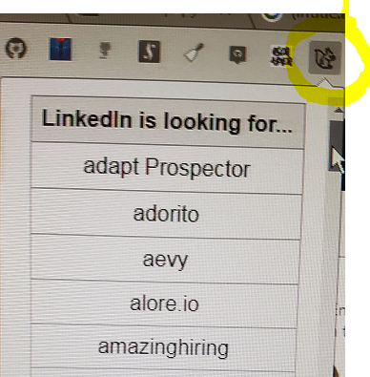
Don’t get on the LinkedIn naughty list – be cautious when using extensions!
Highly recommended extension – Nefarious LinkedIn
* Figure out what extensions LinkedIn is scanning you for.
* When used on LinkedIn, this extension tells you which extensions LinkedIn is scanning your browser for.

Slide 36

Bonus!! Tools to Verify Phone Numbers and Emails

Slide 37
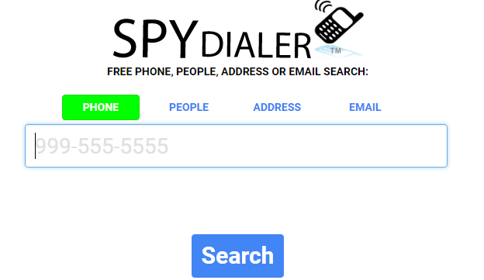
Spydialer
Free to use
Allows you to verify phone numbers, people, address and emails
Please note: Phone could be in their spouses name and could be used by your lead.

Slide 38
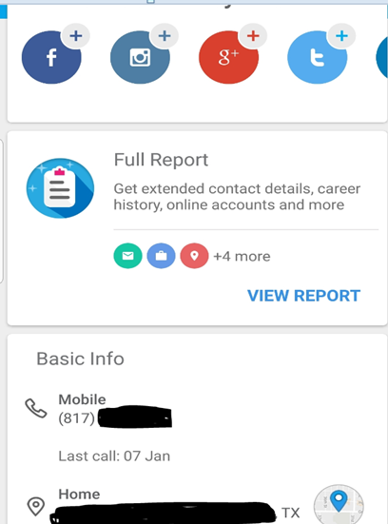
Sync.Me (Android/Iphone)
Paid version -$19.99 per year for premium.
Requires you to call the number (great if you have another phone line)
Full report can provide FB, email and more…
(Free version available on internet but does not work on phone)

Slide 39
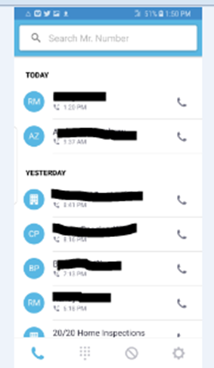
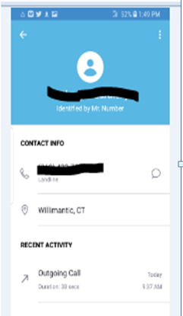
Mr. Number (Android/Iphone)
Free use (Google Play_
Identifies calls
Additional feature, block those spam numbers (or harassing leads)

Slide 40
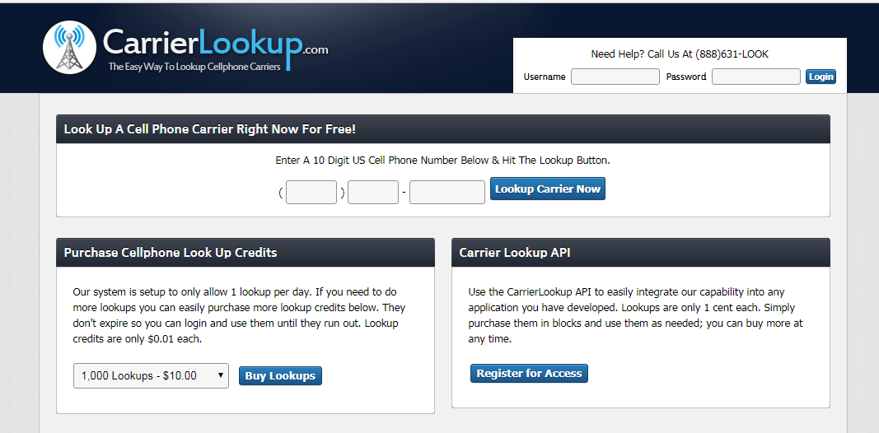

CarrierLookup.com
One free search per day
Tells you who the phone carrier is - great for those that can text through their ATS system.

Slide 41
Questions?
Thank you!
Contact me @
Trish Wyderka
trish@fideliscompanies.com
www.linkedin.com/in/trishwyderka/
Twitter: @trishhasfun

